Slide 1

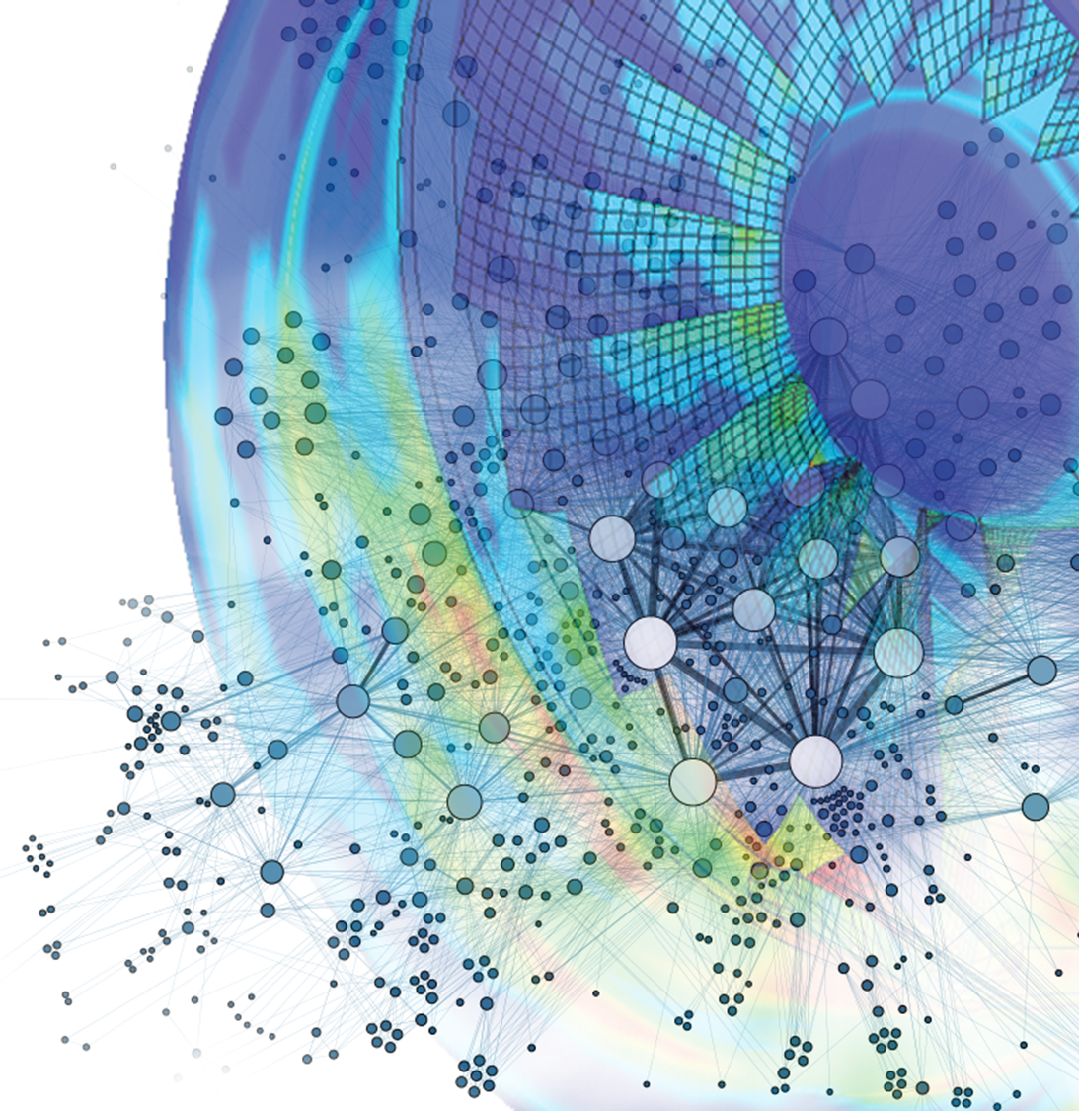

GT2021-65169
Tutorial of basics
On the use of Neural Networks in turbomachinery blade design
Alessandro Corsini, Giovanni Delibra, Lorenzo Tieghi and Francesco Aldo Tucci
Sapienza University of Rome,
Department of Mechanical and Aerospace Engineering
ASME Turbo Expo 2021
Turbomachinery Technical Conference and Exposition
June 7 – 11, Virtual, Online

Slide 2
Outline
Basics elements of neural networks
Neural network – Live programming
Neural network in turbomachinery design
Q&A

Slide 3

What is a neural network?
Machine Learning
Key factors of Neural Networks
MORPHOLOGY
conceives the physical brain
TRAINING PROCESS
mimics the learning process of human brain
Neural Network
Current impact of Neural Networks
Fault Diagnosis and Prognosis
Turbomachinery Performance Prediction
Self-driving vehicles
Facial and speech recognition
Weather forecasting
Stock exchange forecasting
Patterns
Data
CLASSIFICATION
SUPERVISED LEARNING
Develops a predictive model based on both input and output data
Output
REGRESSION

Slide 4
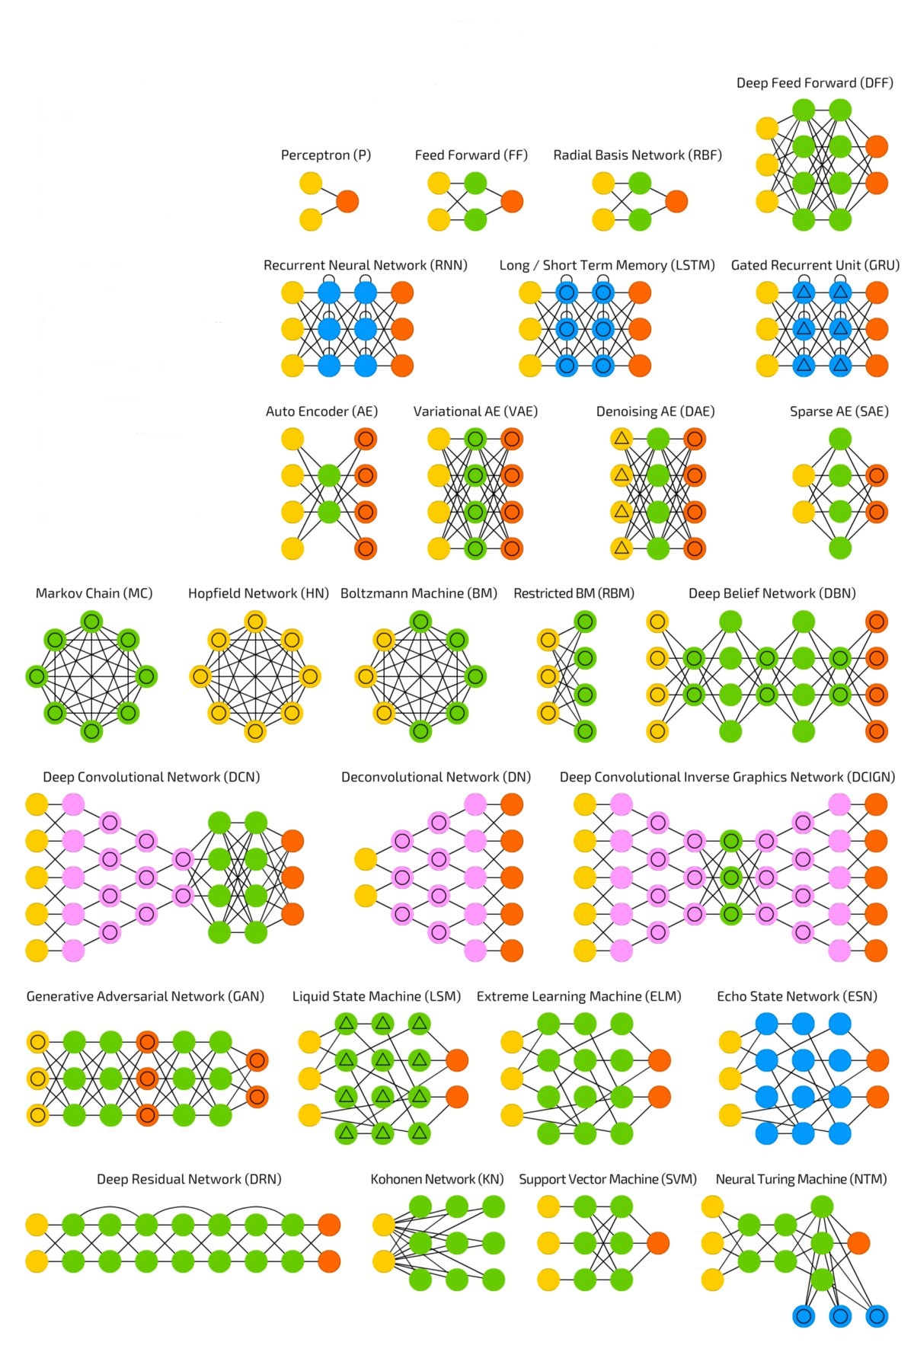
Neural Network Architectures
A mostly complete chart of Neural Networks¹
[1]. Van Veen, F. & Leijnen, S. (2019). The Neural Network Zoo. Retrieved from https://www.asimovinstitute.org/neural-network-zoo

Slide 5
Neural Network Basic Architecture
Any network can be seen as a sum of basic units called artificial neurons
𝒇:𝒙→𝒚
y: Output layer
x: Input layer
Hidden layers

Slide 6







Neural Network basic elements
Hyperparameters
remains the same during the learning process
Neural network model:$f_{θ}:x→y$
Parameters of the model: $θ$
Weights and Biases
optimized during the learning process
General Perceptron
Input
Output
$$x$$
$$w$$
$$n$$
$$y$$
$$Σ$$
$$Φ$$
$$b$$
$$y= Φ\left(w∙x+b\right)$$

Slide 7



















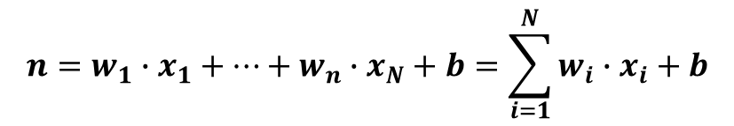


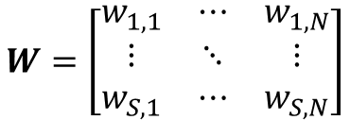












Multi-input neural networks
Layer of S Neuron
From single to multi-Perceptrons
Output
Inputs
Multi-input Perceptron
$$w_{1,1}$$
$$n_{1}$$
$$y_{1}$$
Inputs
$$Σ$$
$$Φ$$
$$x_{1}$$
$$w_{1}$$
Output
$$x_{1}$$
$$n$$
$$b_{1}$$
$$w_{2}$$
$$Σ$$
$$Φ$$
$$y$$
$$x_{2}$$
$$n_{2}$$
$$y_{2}$$
$$x_{2}$$
$$Σ$$
$$Φ$$
$$w_{N}$$
$$x_{N}$$
$$b_{2}$$
$$b$$
$$n_{S}$$
$$x_{N}$$
$$w_{1,N}$$
$$y_{S}$$
…
$$Σ$$
$$Φ$$
…
…
…
$${{n=w}_{1}∙x_{1}+…+w}_{n}∙x_{N}+b=\sum_{i=1}^{N}{w_{i}∙x_{i}+b}$$
$$b_{S}$$
$$y= Φ\left(\sum_{i=1}^{N}{w_{i}∙x_{i}+b}\right)$$
$$y=Φ\left(W∙x+b\right)$$
$$W=\left[\begin{matrix}w_{1,1} & ⋯ & w_{1,N} \\ ⋮ & ⋱ & ⋮ \\ w_{S,1} & ⋯ & w_{S,N}\end{matrix}\right]$$

Slide 8

























































Multi-layer neural networks
Multilayering: the output of a layer are exploited as inputs for the subsequent layer
First Layer
Second Layer
Third Layer
$$n_{1}^{1}$$
$$w_{1,1}^{2}$$
$$n_{1}^{2}$$
$$w_{1,1}^{3}$$
$$n_{1}^{3}$$
$$w_{1,1}^{1}$$
$$Φ^{1}$$
$$y_{1}^{1}$$
$$Φ^{2}$$
$$y_{1}^{2}$$
$$Φ^{3}$$
$$y_{1}^{3}$$
Inputs
$$Σ$$
$$Σ$$
$$Σ$$
$$x_{1}$$
$$b_{1}^{1}$$
$$b_{1}^{2}$$
$$b_{1}^{3}$$
$$x_{2}$$
$$n_{2}^{1}$$
$$n_{2}^{2}$$
$$n_{2}^{3}$$
$$Σ$$
$$Φ^{1}$$
$$y_{2}^{1}$$
$$Σ$$
$$Φ^{2}$$
$$y_{2}^{2}$$
$$Σ$$
$$Φ^{3}$$
$$y_{2}^{3}$$
$$x_{N}$$
$$b_{2}^{1}$$
$$b_{2}^{2}$$
$$b_{2}^{3}$$
$$w_{S^{1},N}^{1}$$
$$n_{S^{1}}^{1}$$
$$n_{S^{2}}^{2}$$
$$n_{S^{3}}^{3}$$
…
$$Σ$$
$$Φ^{1}$$
$$y_{S^{1}}^{1}$$
$$Σ$$
$$Φ^{2}$$
$$y_{S^{2}}^{2}$$
$$Σ$$
$$Φ^{3}$$
$$y_{S^{2}}^{3}$$
$$w_{S^{2},S^{1}}^{2}$$
…
$$w_{S^{3},S^{2}}^{3}$$
…
…
…
…
…
$$b_{S^{1}}^{1}$$
$$b_{S^{2}}^{2}$$
$$b_{S^{3}}^{3}$$
$$y^{1}=Φ^{1}\left(W^{1}x^{1}+b^{1}\right)$$
$$y^{2}=Φ^{2}\left(W^{2}y^{1}+b^{2}\right)$$
$$y^{3}=Φ^{3}\left(W^{3}y^{2}+b^{3}\right)$$
$$y^{3}=Φ^{3}\left(W^{3}Φ^{2}\left(W^{2}Φ^{1}\left(W^{1}x^{1}+b^{1}\right)+b^{2}\right)+b^{3}\right)$$

Slide 9
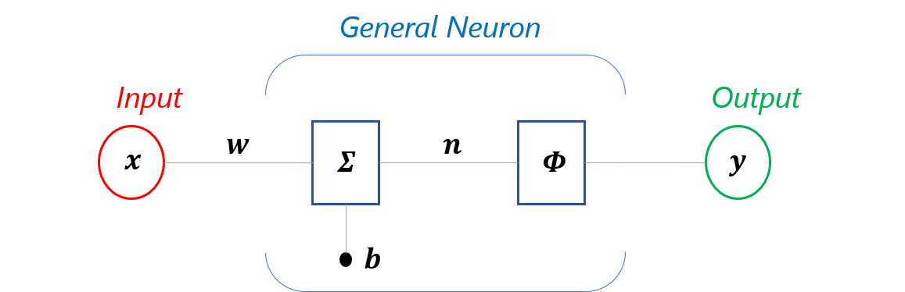
Activation Functions
The activation function $Φ$ is the source of non-linearity of neural networks
linear
sigmoid
Hyperbolic tangent
Heaviside

Slide 10
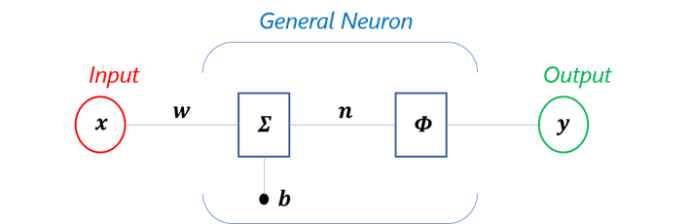


How can I evaluate the accuracy of the model?
The error function $J(w,b)$ provides a measurements of how good the model is at approximating the relationships between model’s inputs and outputs
where $\hat{y_{i}}$ is the expected output of the model and $y_{i}$ is the actual output of the net
The goal is to find the best set of weights and biases and this is achieved minimizing the error
Error
$$\hat{y_{i}}−y$$

Slide 11
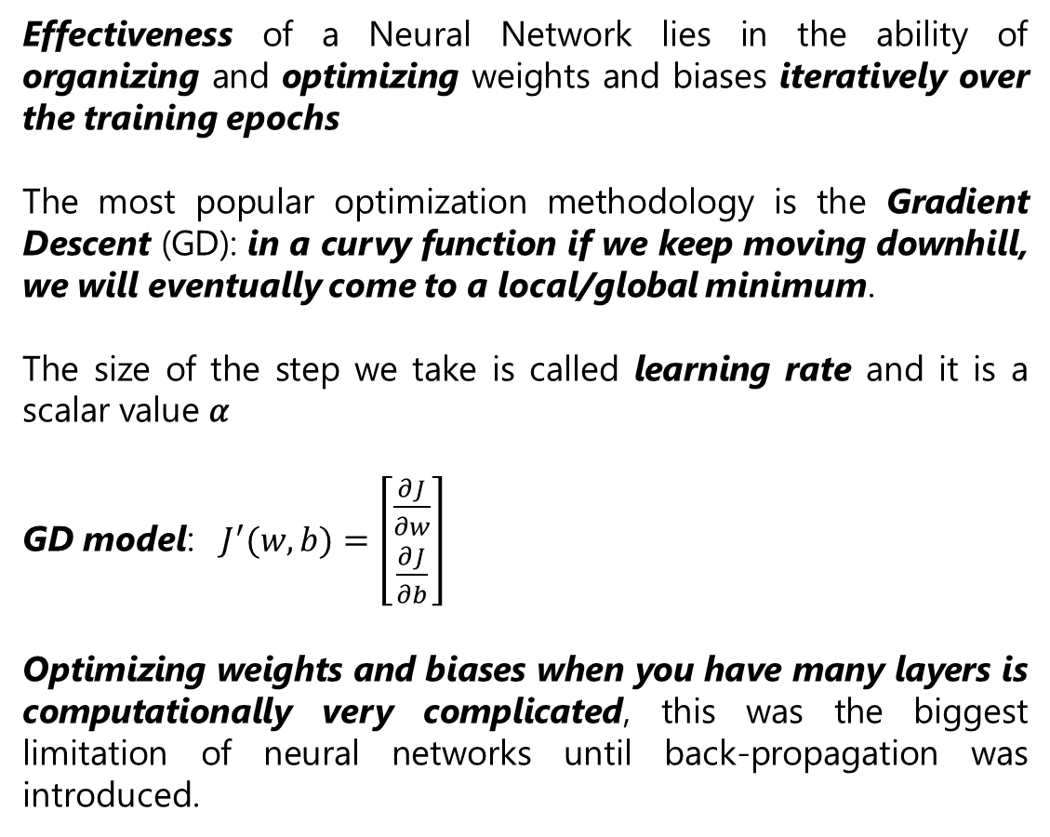
How can I find the best set of weights and biases?
Effectiveness of a Neural Network lies in the ability of organizing and optimizing weights and biases iteratively over the training epochs
The most popular optimization methodology is the Gradient Descent (GD): in a curvy function if we keep moving downhill, we will eventually come to a local/global minimum.
The size of the step we take is called learning rate and it is a scalar value 𝛼
GD model: $J^{′}(w,b)=\left[\begin{matrix}\frac{∂J}{∂w} \\ \frac{∂J}{∂b}\end{matrix}\right]$
Optimizing weights and biases when you have many layers is computationally very complicated, this was the biggest limitation of neural networks until back-propagation was introduced.
Iterations of GD algorithm when fitting data with a linear model 𝒚= 𝜱(𝒘∙𝒙+𝒃)

Slide 12




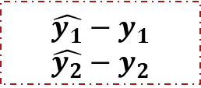









Optimization: Back-propagation
In ML practice Back-propagation is a widely used algorithm for training feedforward neural network
During the training phase the goal is to minimize the error function: $J(w,b)$
Forward propagation
Input is modelled using weights and biases, which are randomly selected
For every neuron, the output is calculated
$$b_{1}^{1}$$
$$b_{1}^{2}$$
$$x_{1}$$
$$b_{2}^{1}$$
$$b_{2}^{2}$$
$$y_{1}$$
Error
$$x_{2}$$
$$\hat{y_{1}}−y_{1}$$
$$\hat{y_{2}}−y_{2}$$
Back-propagation
The error in the output is calculated
Travel back from the output layer to the hidden layer to adjust the weights such that the error is decreased
Iterated over the training epochs
$$b_{3}^{1}$$
$$b_{3}^{2}$$
$$y_{2}$$
$$x_{3}$$
$$b_{4}^{1}$$
$$b_{4}^{2}$$
Forward propagation
Back-propagation

Slide 13
Basics elements of Neural networks
IT’S TIME FOR LIVE PROGRAMMING

